Slide 1


<Stefan Liute>
<03.12.2023>

Slide 2

Outline
Executive Summary
Introduction
Methodology
Results
Conclusion

Slide 3
Executive Summary
A.Methodology
1.Data collection
SpaceX API
Webscraping
2.Data wrangling
3.EDA
SQL(sqlite)
Matplotlib
4.Data visualization
Interactive map: FOLIUM
Interactive dashboard: Plotly DASH
5.Predictive Analysis
Machine Learning
B. Results
1.Data collection
2.Data wrangling
3.EDA
4.Data visualization
5.Predictive analysis
Falcon 9 Launches Dataframe (csv)
Launching outcomes (exported csv file)
Landing success (queries SQL + visualization via matplotlib)
Launch Sites marked, distances calculated
Success rates based on launch site
Logistic Regression, SVM, Classification Tree algorithms used for training/test datasets

Slide 4
Introduction
SpaceX has deployed several spaceships over the years.
SpaceX advertises Falcon 9 rocket launches on its website, with a cost of 62 million dollars; other providers cost upward of 165 million dollars each, much of the savings is because SpaceX can reuse the first stage. Therefore if we can determine if the first stage will land, we can determine the cost of a launch.
In this project we predict if the Falcon 9 stage will land successfully.

Slide 5

Section 1

Slide 6
Methodology
Executive Summary
Data collection methodology:
Perform data wrangling
The collected data was processed using pandas, numpy transforming raw data into usable data for further analysis
Perform exploratory data analysis (EDA) using visualization and SQL
Perform interactive visual analytics using Folium and Plotly Dash
Perform predictive analysis using classification models
How to build, tune, evaluate classification models

Slide 7
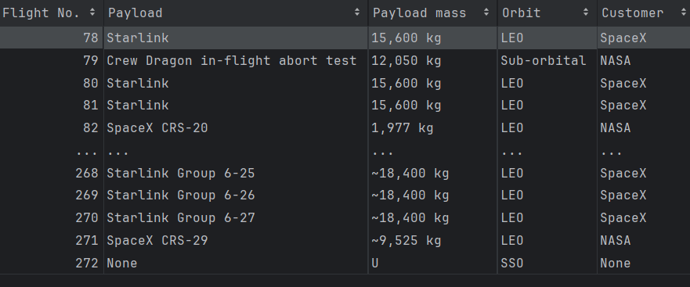
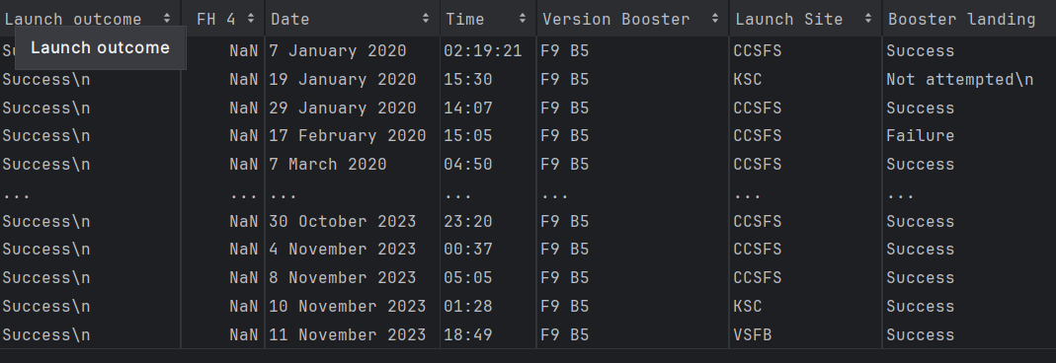
Data Collection
SpaceX API
Webscraping
"https://api.spacexdata.com/v4/launches/past"
"https://en.wikipedia.org/wiki/List_of_Falcon_9_and_Falcon_Heavy_launches"
Collected the useful data for Falcon 9. Cleaned the data and exported it in a csv file.
BoosterVersion PayloadMass Orbit LaunchSite Outcome Flight GridFins Reused Legs LandingPad Block ReusedCount Serial Longitude Latitude
Extracted all the data for the Falcon 9 Launch

Slide 8
Data Collection – SpaceX API
requests
import requests
Request successful
(response code = 200)
Reading data via pandas
pd.json_normalize(df)
Transforming response content to json
Link to GitHub jupyter notebook
Collected Falcon 9 Launch information
response.json

Slide 9
Data Collection - Scraping
Link to GitHub jupyter notebook
Scraped Falcon 9 Launch information from Wikipedia (tables)
requests
Import requests
Response successful
(response code = 200)
BeautifulSoup Parser
‘html’ feature for BS parser
Reading data via pandas

Slide 10
Data Wrangling
Link to GitHub jupyter notebook
Transformed raw data into useful data regarding occurrence for each orbit, outcomes of launches, etc.
Exported it to csv file
Reading data via pandas
Calculating null values
Calculating values for LaunchSites
Number and occurrence for each orbit
Calculating values outcomes (good & bad)

Slide 11
EDA with Data Visualization
Link to GitHub jupyter notebook
Visualized different relationships between Launches and Orbits, outcome information, etc
Reading data via pandas
Seaborn Catplot / Barplot / Lineplot

Slide 12
EDA with SQL
Link to GitHub jupyter notebook
Queried useful info for data visualization
Install sqlalchemy
%load_ext sql
Import csv, sqlite3
Install ibm_db_sa
Ipython-sql
Creating cursor → connecting to SQL Database

Slide 13
Build an Interactive Map with Folium
Created a blue circle at NASA Johnson Space Center's coordinate with a popup label showing its name
For each launch site, I added a Circle object based on its coordinate (Lat, Long) values. In addition, I added the Launch site name as a popup label
Calculated the distance from each launch site to the equator line
Link to GitHub jupyter notebook

Slide 14
Build a Dashboard with Plotly Dash
I added Success vs Failed Launches for all sites (combined or individual)
Total success launches by site
A payload range (kg) criteria with live visualization depending on the value selected
Payload mass vs success for all sites (scatter plot)
Link to GitHub jupyter notebook

Slide 15
Predictive Analysis (Classification)
Reading data via pandas
Data standardization (StandardScaler())
Splitting the data (training vs test sets)
Different Algorithms (Logistic Regression, SVM, Classification Tree, KNN)
Finding the best algorithm (model)
Importing sklearn, pandas, numpy, seaborn
Used Logistic Regression, SVM, Classification Tree, KNN algorithms for the split datasets (defining parameters ➔ GridSearch object ➔ fit the training sets through GridSearch ➔ print the best parameters and the accuracy ➔ plot Confusion Matrix )
Link to GitHub

Slide 16
Results
Exploratory data analysis results
Interactive analytics demo in screenshots
Predictive analysis results

Slide 17

Section 2

Slide 18
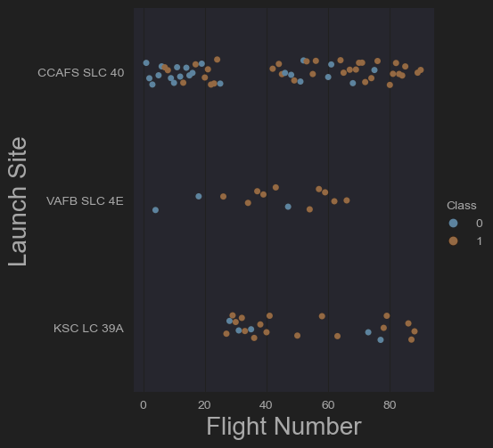
Flight Number vs. Launch Site
We can see from this scatter plot that CCAFS SLC 40 launch site had the most flight numbers and the most failed launches. KSC LC 39A has the best success rate

Slide 19
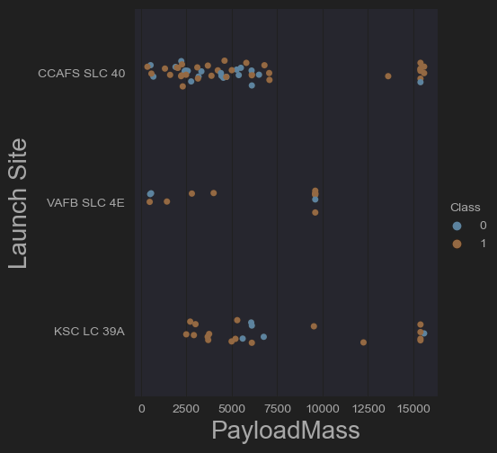
Payload vs. Launch Site
We see that VAFB SLC 4E launch site doesn’t have any launch over 10000 kg (payload mass)
CCAFS SLC 40 doesn’t have any launches between 7500 and approx. 12700 kg (payload mass), and has good launch success rate with payload mass over 15000 kgs along with KSC LC 39A launchsite

Slide 20
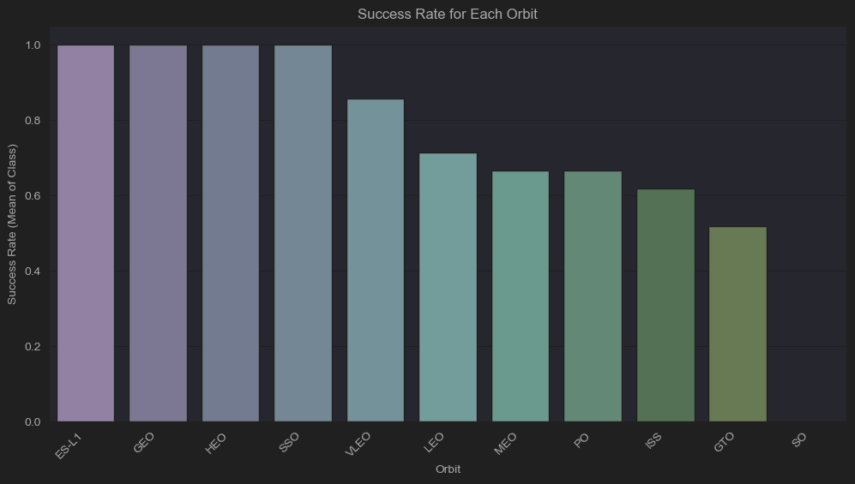
Success Rate vs. Orbit Type
We can see that only the first 4 Orbits have the perfect success rate (1), the 5th one (VLEO) has a success rate of 0.8 and the rest of them have a success rate under 0,8 (SO orbit having the worst success rate – 0)

Slide 21
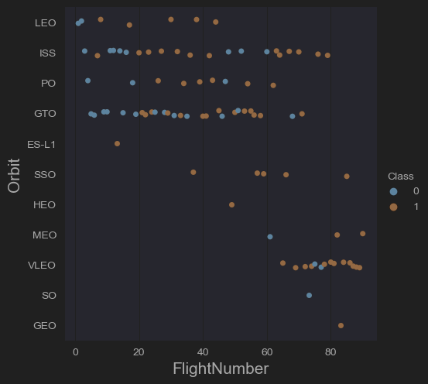
Flight Number vs. Orbit Type
ES-L1, HEO, SO, GEO orbits had only one flight number with only SO orbit having 0 success rate.
We can see that VLEO (the most successful orbit) started at over 60 flights (this could be the result of the improvement process over the years and flights) + it had several flights comparing to other orbits like SO, MEO, SSO, GTO which had under 3 flights launched over the 60th flight number

Slide 22
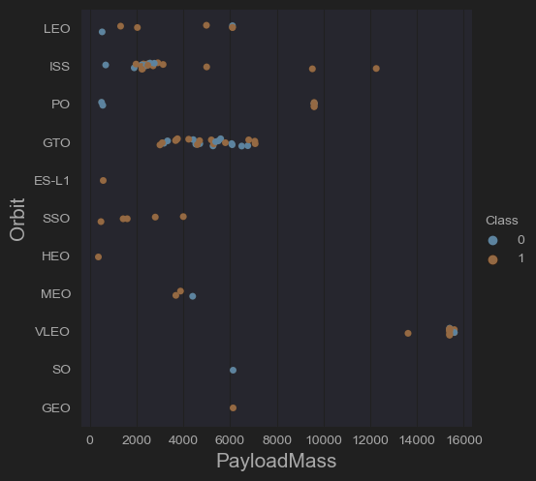
Payload vs. Orbit Type
VLEO (the most successful orbit) had the highest Payload Mass (>14000)

Slide 23
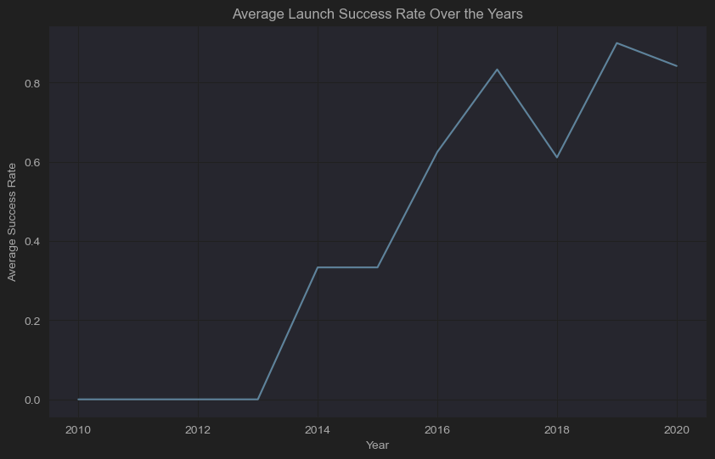
Launch Success Yearly Trend
From 2010 to 2013 the progress was stagnating. Since 2013 the success went higher until 2014-2015 (stall) then it started to progress until 2017 when it had a regress until 2018. 2018-2019 was an increasing trend until 2019 when it slightly decreased (until 2020 – the last year we have the data on)
Overall, the average launch success rate is increasingly higher. This shows a clear improvement in technology, methodology of SpaceX launches.

Slide 24
All Launch Site Names
%sql SELECT DISTINCT Launch_Site FROM SPACEXTABLE
'CCAFS LC-40’,
'VAFB SLC-4E’
'KSC LC-39A’
'CCAFS SLC-40'

Slide 25
Launch Site Names Begin with 'CCA'
5 examples of site names starting with ‘CCA’. The query involves useful data like date&hour of the launch, BoosterVersion, site name, Outcome (success or failure)
* sqlite:///my_data1.db
Done.
[('2010-06-04', '18:45:00', 'F9 v1.0 B0003', 'CCAFS LC-40', 'Dragon Spacecraft Qualification Unit', 0, 'LEO', 'SpaceX', 'Success', 'Failure (parachute)'),
('2010-12-08', '15:43:00', 'F9 v1.0 B0004', 'CCAFS LC-40', 'Dragon demo flight C1, two CubeSats, barrel of Brouere cheese', 0, 'LEO (ISS)', 'NASA (COTS) NRO', 'Success', 'Failure (parachute)'),
('2012-05-22', '7:44:00', 'F9 v1.0 B0005', 'CCAFS LC-40', 'Dragon demo flight C2', 525, 'LEO (ISS)', 'NASA (COTS)', 'Success', 'No attempt'),
('2012-10-08', '0:35:00', 'F9 v1.0 B0006', 'CCAFS LC-40', 'SpaceX CRS-1', 500, 'LEO (ISS)', 'NASA (CRS)', 'Success', 'No attempt'),
('2013-03-01', '15:10:00', 'F9 v1.0 B0007', 'CCAFS LC-40', 'SpaceX CRS-2', 677, 'LEO (ISS)', 'NASA (CRS)', 'Success', 'No attempt')]

Slide 26
Total Payload Mass
total payload carried by boosters from NASA(CRS)
%sql SELECT SUM(PAYLOAD_MASS__KG_) FROM SPACEXTABLE
* sqlite:///my_data1.db
Done.
619967 (kg)

Slide 27
Average Payload Mass by F9 v1.1
Average Payload Mass (kg) for Booster F9 v1.1
* sqlite:///my_data1.db
Done.
2928.4 (kg)

Slide 28
First Successful Ground Landing Date
The first successful ground landing date
* sqlite:///my_data1.db
Done.
[('2015-12-22',)]

Slide 29
Successful Drone Ship Landing with Payload between 4000 and 6000
The Booster Versions where landing outcome was successful (drone ship) → output below
* sqlite:///my_data1.db
Done.
[('F9 FT B1022',), ('F9 FT B1026',), ('F9 FT B1021.2',), ('F9 FT B1031.2',)]

Slide 30
Total Number of Successful and Failure Mission Outcomes
* sqlite:///my_data1.db
Done.
* sqlite:///my_data1.db
Done.
+------------------------+
| COUNT(Mission_Outcome) | SUCESSFUL
+------------------------+
| 100 |
+------------------------+ +------------------------+
| COUNT(Mission_Outcome) | FAILED
+------------------------+
| 1 |
+------------------------+

Slide 31
Boosters Carried Maximum Payload
Selected all the distinct names of boosters that carried the max payload
('F9 v1.0 B0003',),
('F9 v1.0 B0004',),
('F9 v1.0 B0005',),
('F9 v1.0 B0006',),
('F9 v1.0 B0007',),
('F9 v1.1 B1003',),
('F9 v1.1',),
('F9 v1.1 B1011',),
('F9 v1.1 B1010',),
('F9 v1.1 B1012',),
('F9 v1.1 B1013',),
('F9 v1.1 B1014',),
('F9 v1.1 B1015',),
('F9 v1.1 B1016',),
('F9 v1.1 B1018',),
('F9 FT B1019',),
('F9 v1.1 B1017',),
('F9 FT B1020',),
('F9 FT B1021.1',),
('F9 FT B1022',),
('F9 FT B1023.1',),
('F9 FT B1024',),
('F9 FT B1025.1',),
('F9 FT B1038.1',),
('F9 B4 B1040.1',),
('F9 B4 B1041.1',),
('F9 FT B1031.2',),
('F9 B4 B1042.1',),
('F9 FT B1035.2',),
('F9 FT B1036.2',),
('F9 B4 B1043.1',),
('F9 FT B1032.2',),
('F9 FT B1038.2',),
('F9 B4 B1044',),
('F9 B4 B1041.2',),
('F9 B4 B1039.2',),
('F9 B4 B1045.1',),
('F9 B5 B1046.1',),
('F9 B4 B1043.2',),
('F9 B4 B1040.2',),
('F9 B4 B1045.2',),
('F9 B5B1047.1',),
('F9 B5B1048.1',),
('F9 B5 B1046.2',),
('F9 B5B1049.1',),
('F9 B5 B1048.2',),
('F9 B5 B1056.3 ',),
('F9 B5 B1049.4',),
('F9 B5 B1046.4',),
('F9 B5 B1051.3',),
('F9 B5 B1056.4',),
('F9 B5 B1059.2',),
('F9 B5 B1048.5',),
('F9 B5 B1051.4',),
('F9 B5B1058.1 ',),
('F9 B5 B1049.5',),
('F9 B5 B1059.3',),
('F9 B5B1060.1',),
('F9 B5 B1058.2 ',),
('F9 B5 B1051.5',),
('F9 B5 B1049.6',),
('F9 B5 B1059.4',),
('F9 B5 B1060.2 ',),
('F9 B5 B1058.3 ',),
('F9 B5 B1051.6',),
('F9 B5 B1060.3',),
('F9 B5B1062.1',),
('F9 B5B1061.1 ',),
('F9 B5B1063.1',),
('F9 B5 B1049.7 ',),
('F9 B5 B1058.4 ',)]
('F9 FT B1026',),
('F9 FT B1029.1',),
('F9 FT B1031.1',),
('F9 FT B1030',),
('F9 FT B1021.2',),
('F9 FT B1032.1',),
('F9 FT B1034',),
('F9 FT B1035.1',),
('F9 FT B1029.2',),
('F9 FT B1036.1',),
('F9 FT B1037',),
('F9 B4 B1039.1',),
('F9 B5 B1047.2',),
('F9 B5 B1046.3',),
('F9 B5B1050',),
('F9 B5B1054',),
('F9 B5 B1049.2',),
('F9 B5 B1048.3',),
('F9 B5B1051.1',),
('F9 B5B1056.1 ',),
('F9 B5 B1049.3',),
('F9 B5 B1051.2 ',),
('F9 B5 B1056.2 ',),
('F9 B5 B1047.3 ',),
('F9 B5 B1048.4',),
('F9 B5B1059.1',),

Slide 32
2015 Launch Records
* sqlite:///my_data1.db
Done.
[('01', 'Failure (drone ship)', 'F9 v1.1 B1012', 'CCAFS LC-40'),
('04', 'Failure (drone ship)', 'F9 v1.1 B1015', 'CCAFS LC-40')]

Slide 33
Rank Landing Outcomes Between 2010-06-04 and 2017-03-20
Ranking landing outcomes (included the ones that didn’t attempt – no=10)
* sqlite:///my_data1.db
Done.
[('No attempt', 10),
('Success (drone ship)', 5),
('Failure (drone ship)', 5),
('Success (ground pad)', 3),
('Controlled (ocean)', 3),
('Uncontrolled (ocean)', 2),
('Failure (parachute)', 2),
('Precluded (drone ship)', 1)]

Slide 34

Section 3

Slide 35
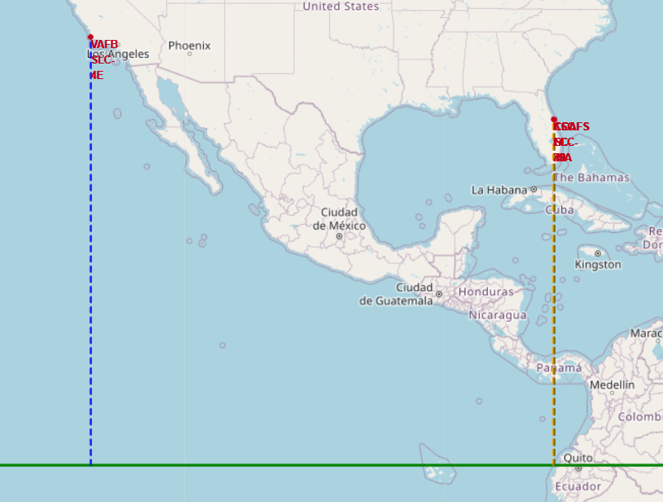
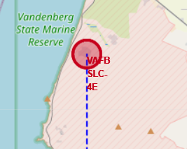
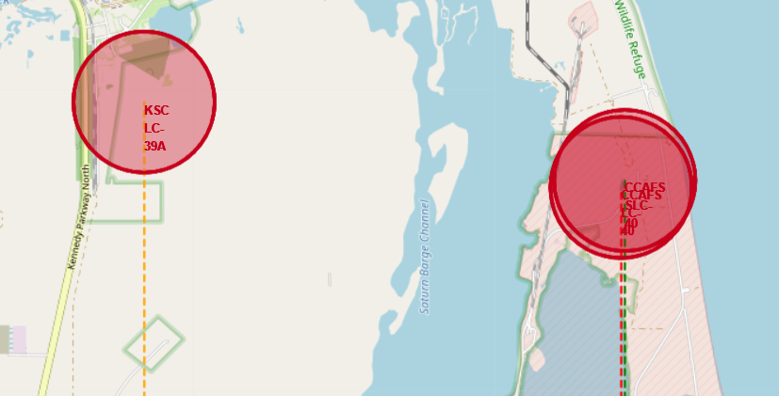
Launch Sites marks on the map and the distance to equator line

Slide 36

Section 4

Slide 37
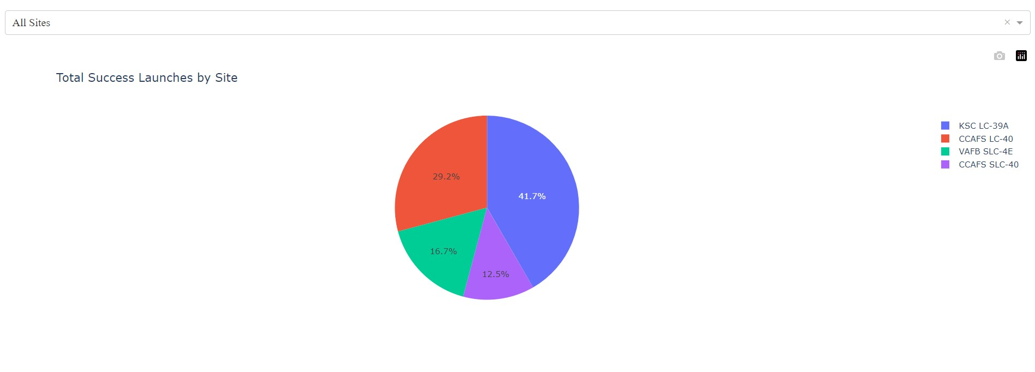
Success rate of launches by site

Slide 38
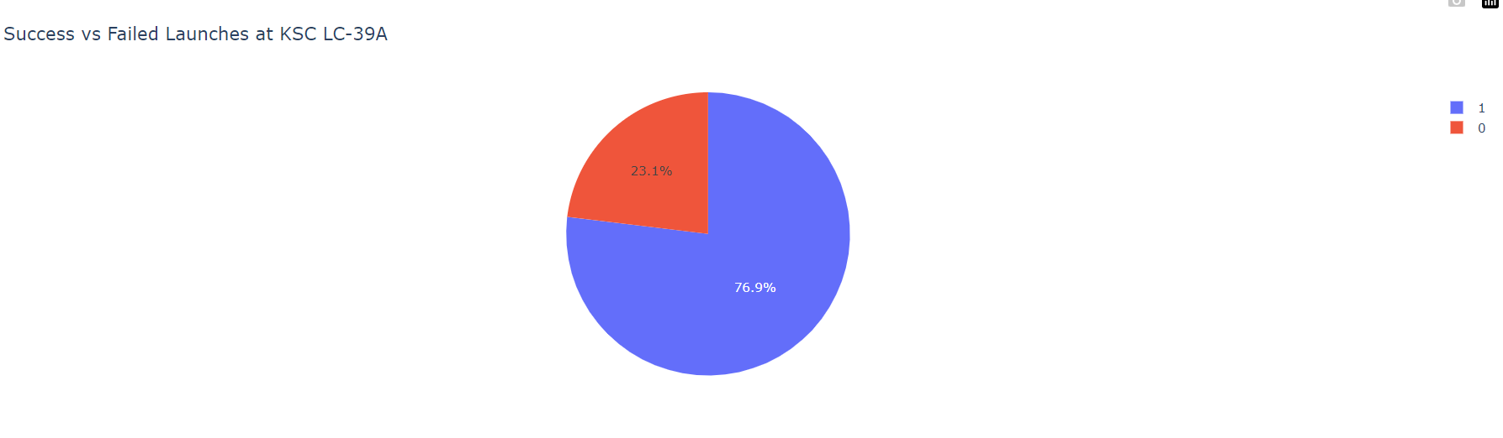
KSC LC-39A detailed info

Slide 39
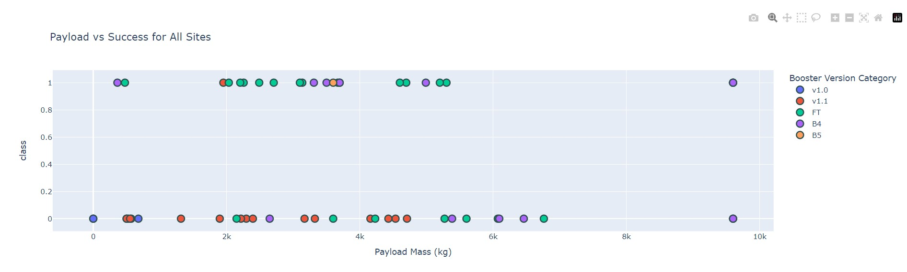
Payload vs Launch outcome

Slide 40

Section 5

Slide 41
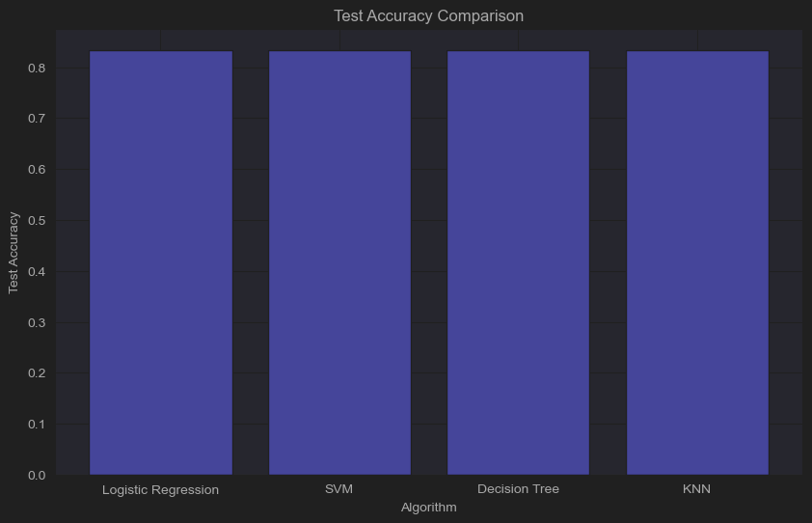
Classification Accuracy
Algorithm Precision Recall F1-Score ROC AUC
0 Logistic Regression 0.800000 1.000000 0.888889 0.750000
1 SVM 0.800000 1.000000 0.888889 0.750000
2 Decision Tree 0.909091 0.833333 0.869565 0.833333
3 KNN 0.800000 1.000000 0.888889 0.750000

Slide 42
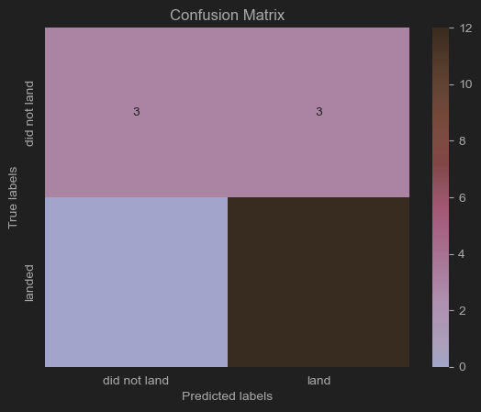
Confusion Matrix

Slide 43
Conclusions
In this case SVM, LR, KNN models are the best

Slide 44


